Slide 1
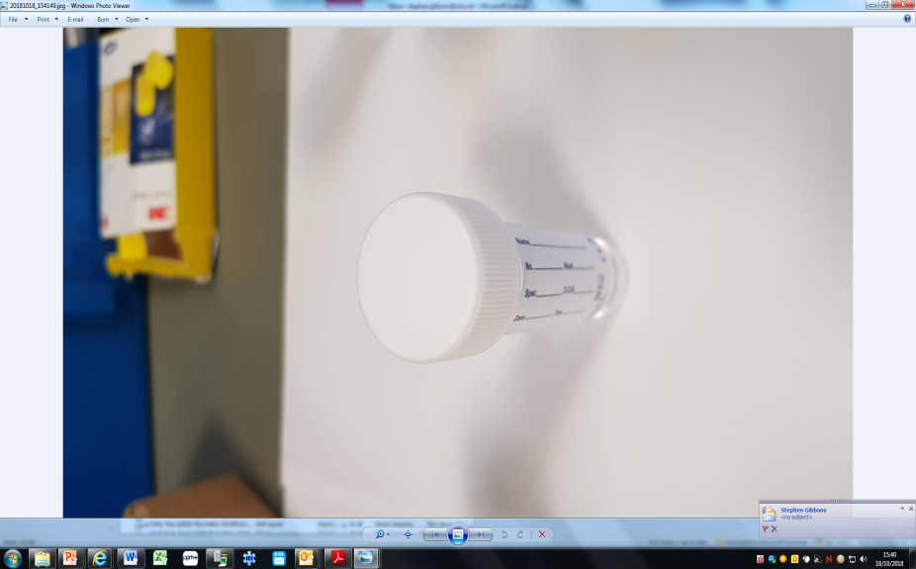
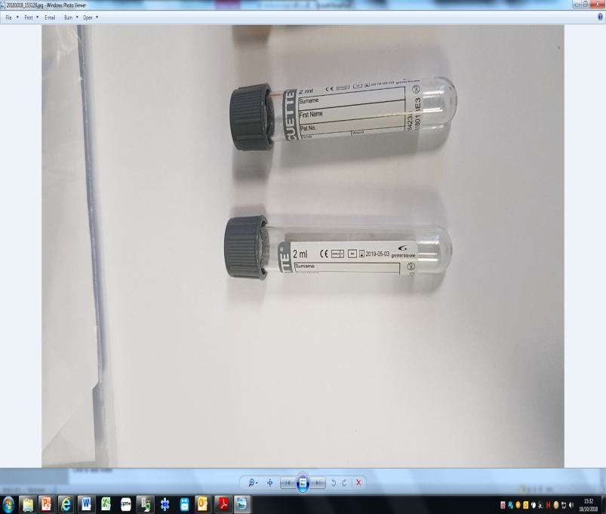
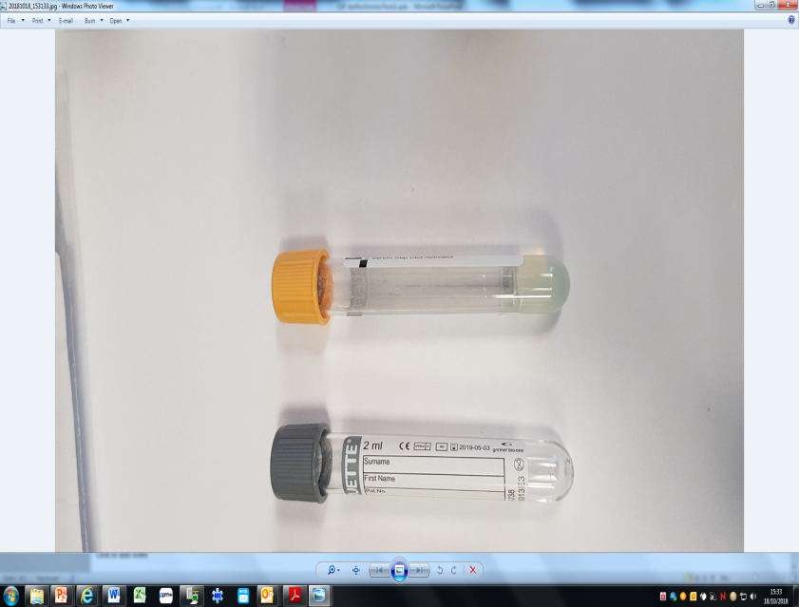
CSF Xanthochromia Collection
Why do we test: CSF Xanthochromia is a second line test which can be useful in the diagnosis of SAH in patients with negative CT head.
STEP 1: Collect CSF into Tubes 1, 2, 3 & 4 plus one grey vacutainer
STEP 2: Collect paired blood into 1 x grey and 1 x yellow vacutainer
CSF
BLOOD
T1
T2
T3
T4
INSIDE WHITE ENVELOPE
MICROBIOLOGY SAMPLE BAG
BIOCHEMISTRY SAMPLE BAG
STEP 3: T1 & T3 into Micro bag
STEP 4: T4 into a white envelope or wrap in foil (PROTECT FROM LIGHT)
STEP 5: ALL Vacutainers (2x grey and 1x yellow), the T2 white universal AND T4 (protected from light) into the sample bag labelled Biochemistry.
STEP 6: HAND DELIVER (within 30mins) both sample bags to pathology reception.
For Same day analysis ensure sample arrives to laboratory before 16:00

