Slide 1
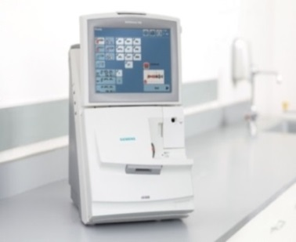
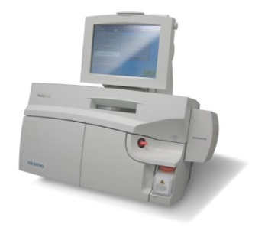
SIEMENS RP500 and RL1200 Blood Gas Machine Out of Hours Breakdown Procedure
NEW: This procedure will be in place from Friday 4th December 2020
POCT SERVICE HOURS
08:30-17:00
Mon - Sat
DO NOT contact the lab/SIEMENS in these hours, POCT will resolve any errors
Contact POCT on
 22338 / 64791 or 07775996028
RP500
RL1200
OUT OF POCT SERVICE HOURS…
If a cartridge needs replacing…
(Take note of the test cartridge size required - refer to the analyser locations poster)
Contact Biochemistry for the site that you are located
LGI 80-2486
SJUH 80-6234
or via switchboard
Error not relating to cartridge change, contact Siemens.
Replace the cartridge(s)
USING THE INSTRUCTION SHEET + PASSWORD PROVIDED BY THE LAB
N.B. once a cartridge reaches room temperature, it MUST be installed on the analyser
CARPS a Porter/send a staff member to collect the cartridge/s from the lab
LGI → Core Lab in the Old Medical School
SJUH → Core Lab in Block 31/32
If any errors occur after a cartridge change
Contact SIEMENS:
 (9) 0845 600 1955
To seek advice
Contact SIEMENS:
 (9)0845 600 1955
If the issue does not require a cartridge change
EMAIL POCT! If any issues occur with the OOH procedure
 leedsth-tr.pointofcare@nhs.net
CC: the Nurse in Charge

